Slide 1
Life Sciences Masters™
IPWATCHDOG STUDIOS, ASHBURN, VA
OCT. 16-18, 2023

Slide 2
CRISPR/Cas9 Editing

Slide 3
CRISPR/Cas Patents at a Glance
15,000+ Patent Families
CENTREDOC - August 2022 monthly update

Slide 4
Cas9 Major Players
Cas9 Foundational IP
Broad/MIT/Harvard
CVC (Cal/Vienna/Charpentier)
Exclusively licensed to:
CRISPR Therapeutics*
Intellia Therapeutics*
Editas Medicine*
Caribou Biosciences
ERS Genomics
*For human therapeutic use

Slide 5
How CRISPR Works
Cas9 precisely binds DNA by sgRNA guidance and generates double-strand break (DSB) at a specific site of the target DNA
CRISPR editing of genetic sequences can be used to:
(i) inactivate genes or delete DNA segments by non-homologous end joining (NHEJ) or
(ii) insert DNA templates into the gene via homology directed repair (HDR)
Jinek, M. A programmable dual-RNA-guided DNA endonuclease in adaptive bacterial immunity. Science. 337(6096):816-821(2012).

Slide 6
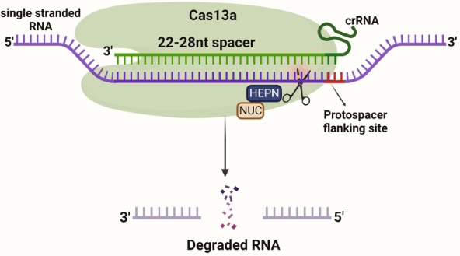
Exemplary Alternative Cas Nucleases
Cas12
Zetsche, B. et al. Cpf1 is a single RNA-guided endonuclease of a class 2 CRISPR-Cas system. Cell. 163:759–771(2015).
CasX
Liu, J. et al. CasX enzymes comprise a distinct family of RNA-guided genome editors. Nature. 566(7743):218-223(2019).
Cas13
Abudayyeh, O.O. et al. C2c2 is a single-component programmable RNA-guided RNA-targeting CRISPR effector. Science 353, aaf5573 (2016); East-Seletsky, A. et al. Two distinct RNase activities of CRISPR-C2c2 enable guide-RNA processing and RNA detection. Nature 538, 270–273 (2016).
Hillary, V.E. & Ceasar, S.A. A Review on the Mechanism and Applications of CRISPR/Cas9/Cas12/Cas13/Cas14 Proteins Utilized for Genome Engineering. Mol Biotechnol. 65(3):311-325(2023).

Slide 7
Precision Base Editing

Slide 8
Base Editing Mechanism
Allows introduction of point mutations in DNA without generating double-strand break (DSB)
used for correcting genetic mutations and targeting/inactivating disease modifier genes
can genetically alter a wide variety of cell types
Antoniou, P. et al. Base and Prime Editing Technologies for Blood Disorders. Front Genome Ed. 3:618406(2021).

Slide 9
Prime Editing

Slide 10
Prime Editing Mechanism
Use of an extended guide RNA (pegRNA) eliminates the requirement for a PAM (protospacer adjacent motif) sequence adjacent to a target site
can be used for point mutations, insertions, and deletions, substitutions, or a combination thereof
less DNA off-target activity compared to CRISPR/Cas9
Godbout, K. & Tremblay, J.P. Prime Editing for Human Gene Therapy: Where Are We Now? Cells – Review. 12(4):536(2023)

Slide 11
Comparisons of different Editing Techniques

Slide 12
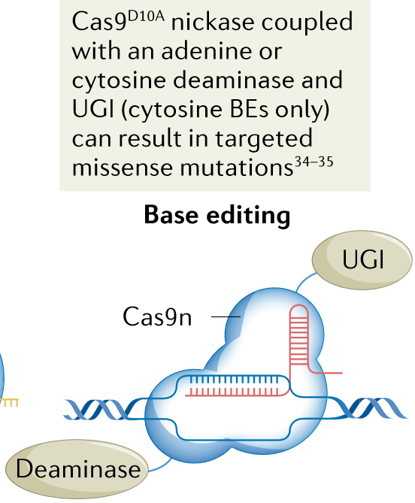
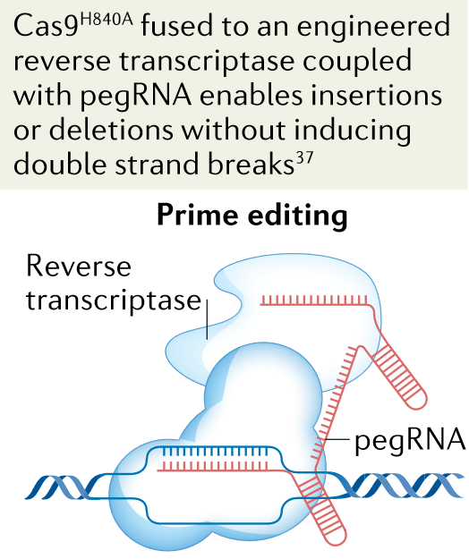
Comparison of CRISPR/Cas9, Base Editing, and Prime Editing
Katti, A. et al. CRISPR in cancer biology and therapy. Nature Reviews Cancer. 22:259-279(2022)

Slide 13
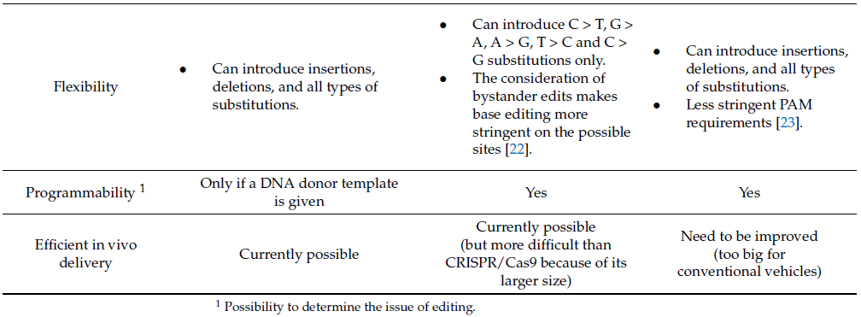
Comparison of CRISPR/Cas9, Base Editing, and Prime Editing
Godbout, K. & Tremblay, J.P. Prime Editing for Human Gene Therapy: Where Are We Now? Cells – Review. 12(4):536(2023)

Slide 14
Complexity of Patent Landscapes: Cas9 vs. Cas12a

Slide 15
Cas9: Assignee Collaboration Map
These charts were created on the Questel's IP Business Intelligence application Orbit Intelligence. More information available at questel.com.

Slide 16
Cas12a: Assignee Collaboration Map
These charts were created on the Questel's IP Business Intelligence application Orbit Intelligence. More information available at questel.com.

Slide 17
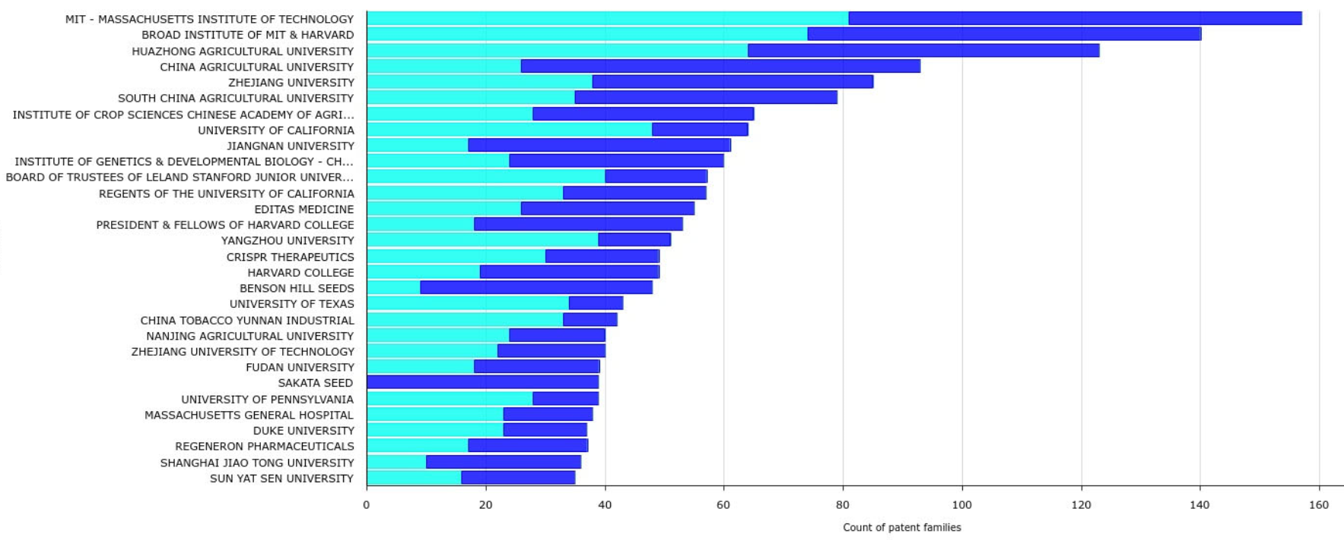
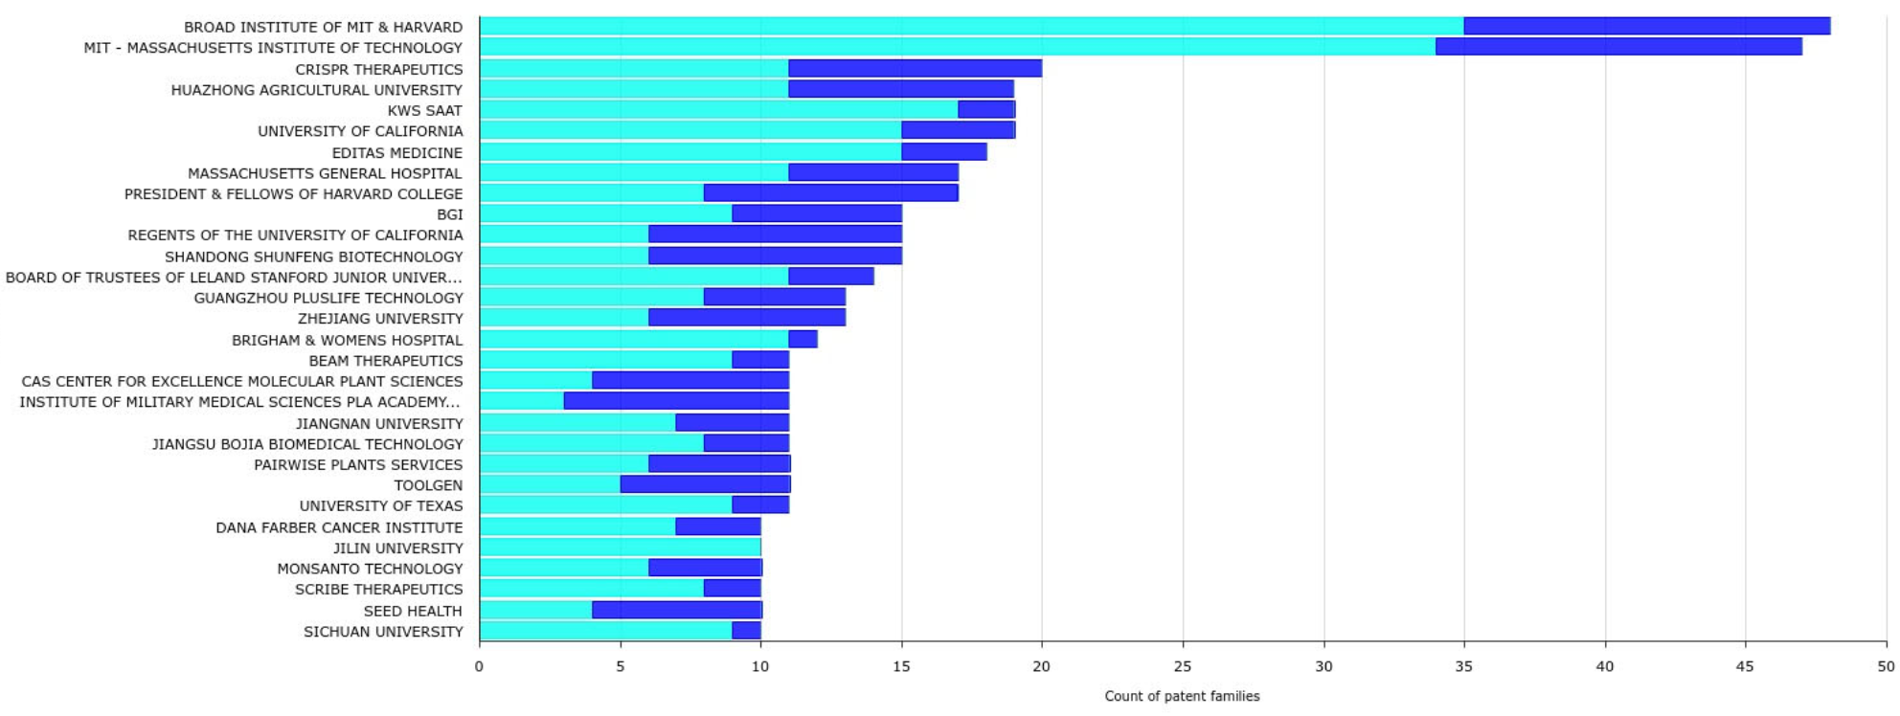
Cas9: Top 30 Assignees by Family (X-Axis Scale is to 160 Families)
Cas12a: Top 30 Assignees by Family (X-Axis Scale is to 50 Families)
These charts were created on the Questel's IP Business Intelligence application Orbit Intelligence. More information available at questel.com.

Slide 18
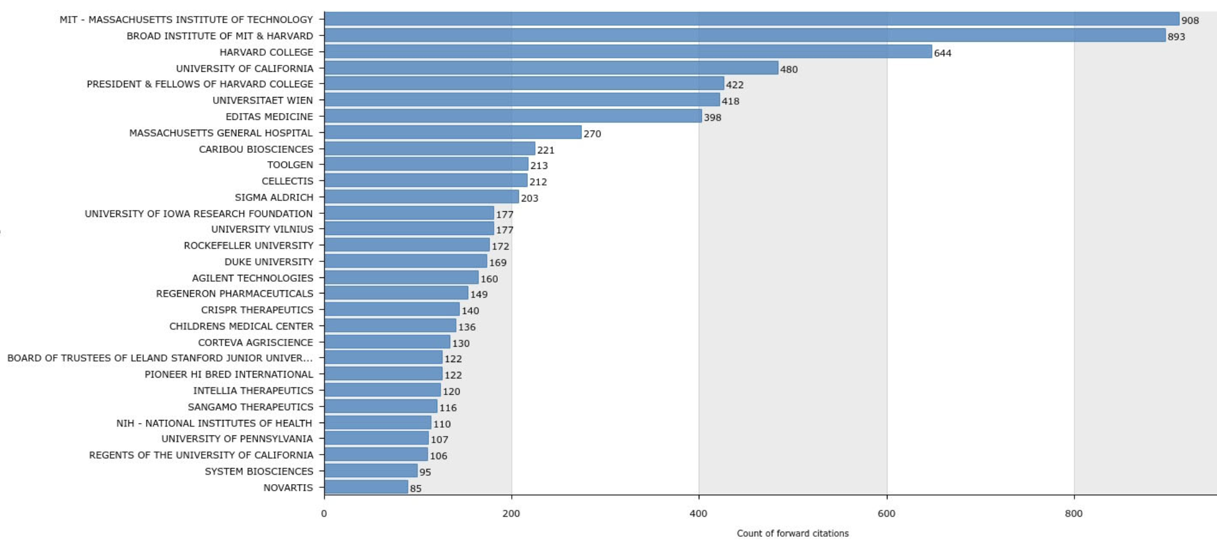
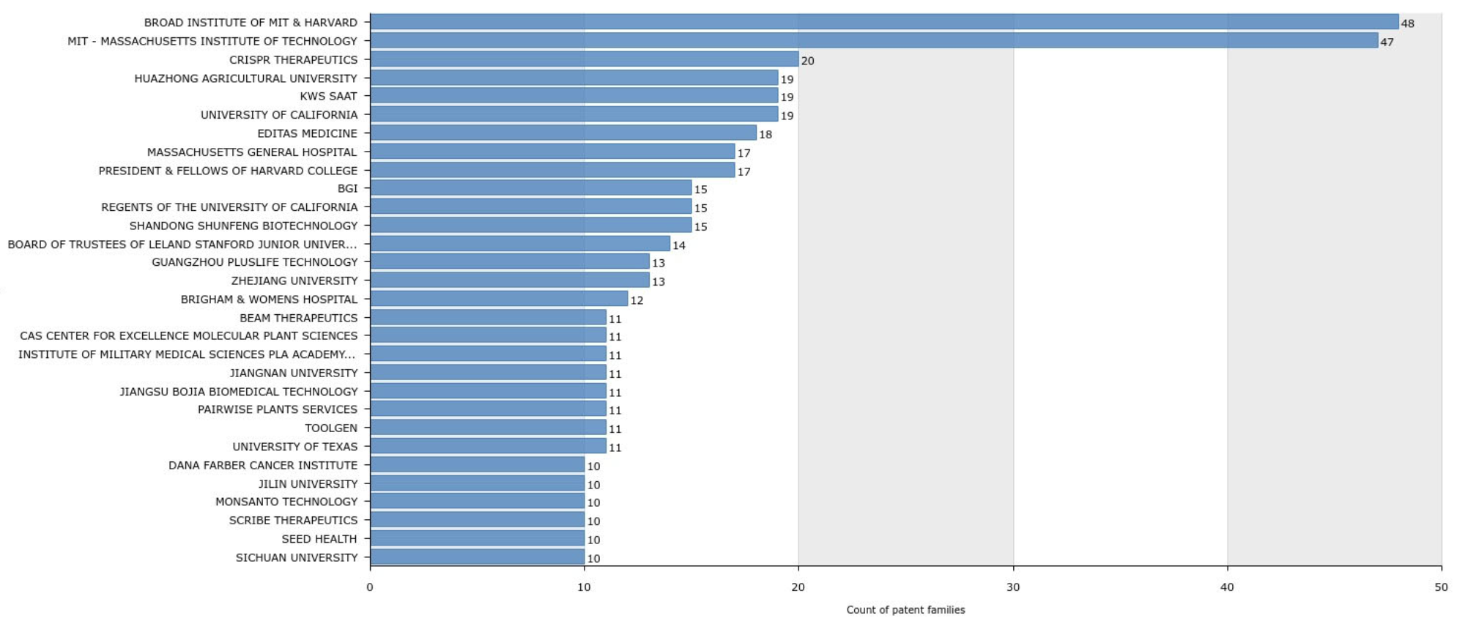
Cas9: Top Assignees With Pats/Apps Cited by Later Pats/Apps (X-Axis Scale is to 1,000 Forward Citations)
Cas12a: Top Assignees With Pats/Apps Cited by Later Pats/Apps (X-Axis Scale is to 50 Forward Citations)
These charts were created on the Questel's IP Business Intelligence application Orbit Intelligence. More information available at questel.com.

Slide 19
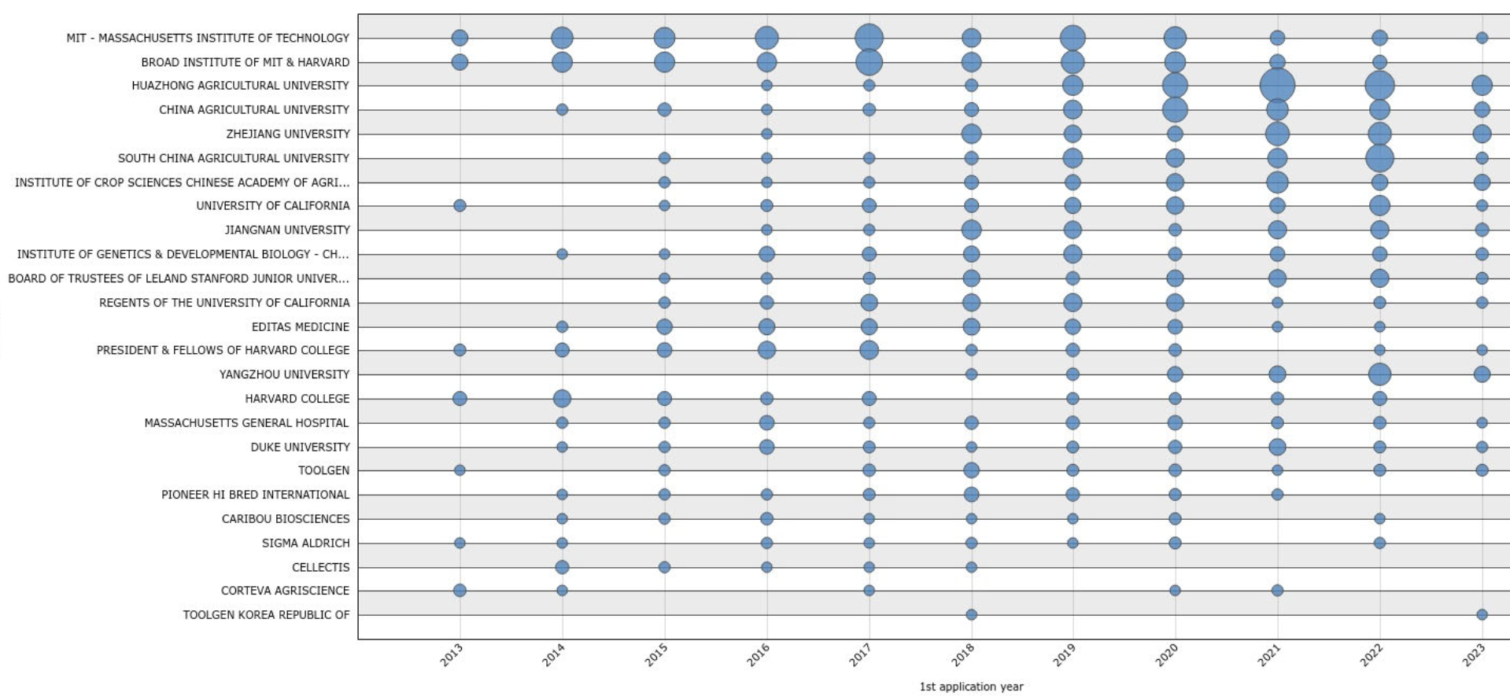
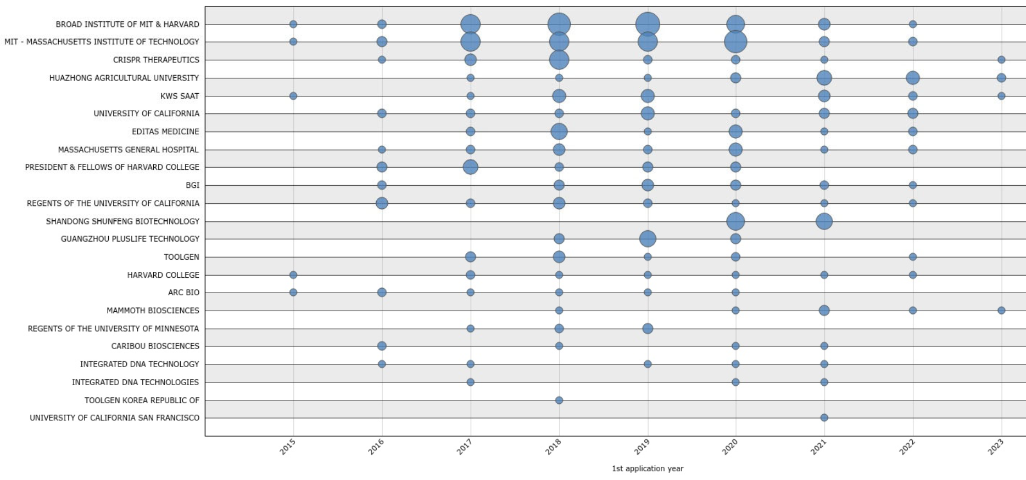
Cas9: Top Assignees by Year (Pending and Granted)
Organizations with 50 or More Pats/Apps
Organizations with at Least 1 Top Cited Pat/App plus at Least 5 Total Pats/Apps
Cas12a: Top Assignees by Year (Pending & Granted)
Organizations with 15 or More Pats/Apps
Organizations with at Least 1 Top Cited Pat/App plus at Least 5 Total Pats/Apps
These charts were created on the Questel's IP Business Intelligence application Orbit Intelligence. More information available at questel.com.

Slide 20
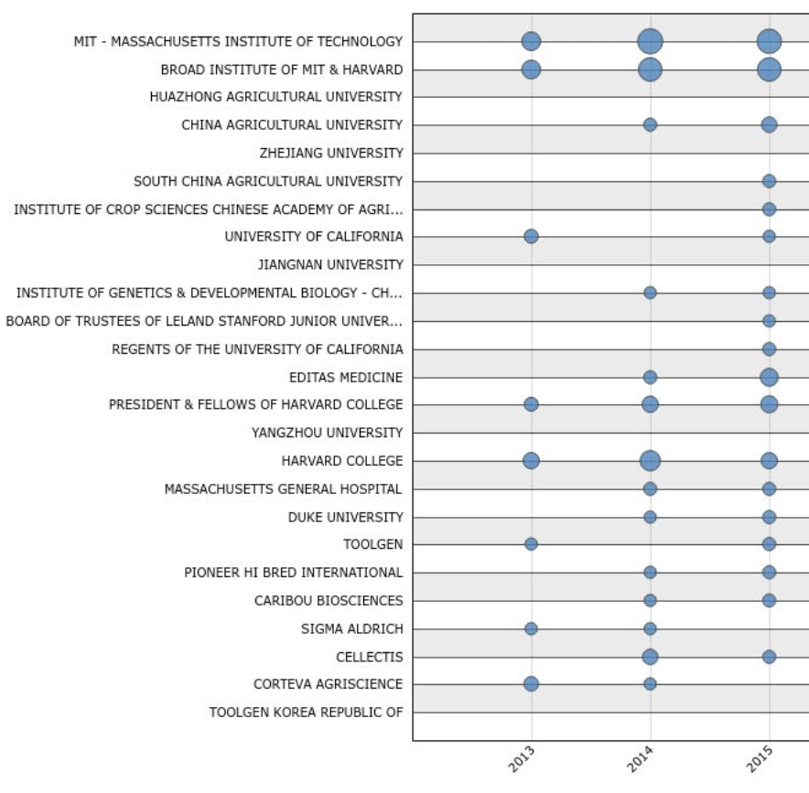
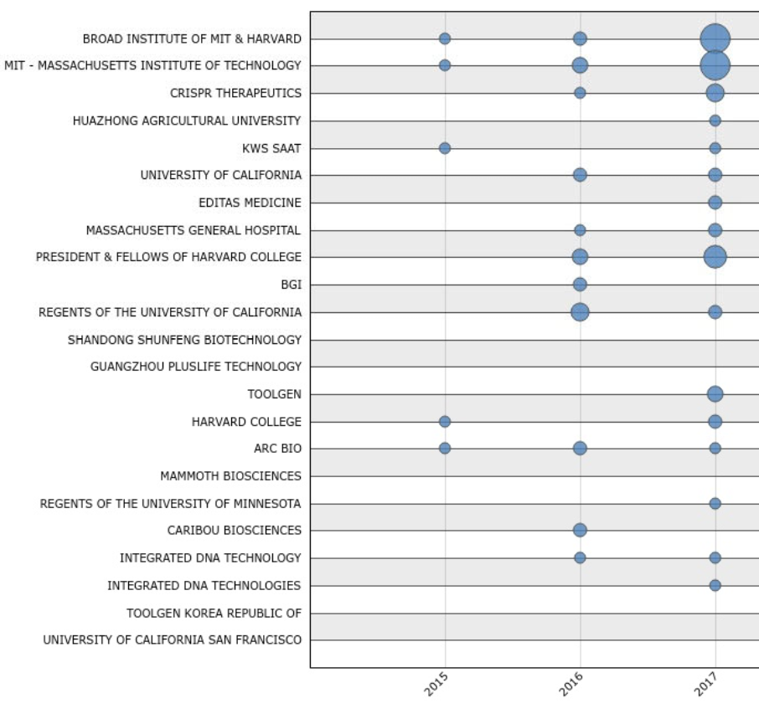
Cas9: Top Assignees by Year (Pending & Granted)
Organizations with 50 or More Pats/Apps
Organizations with at Least 1 Top Cited Pat/App plus at Least 5 Total Pats/Apps
Cas12a: Top Assignees by Year (Pending & Granted)
Organizations with 15 or More Pats/Apps
Organizations with at Least 1 Top Cited Pat/App plus at Least 5 Total Pats/Apps
These charts were created on the Questel's IP Business Intelligence application Orbit Intelligence. More information available at questel.com.

Slide 21
China Currently is the Most Prolific Filer of CRISPR Cas9 & Cas12a Patents & Applications

Slide 22
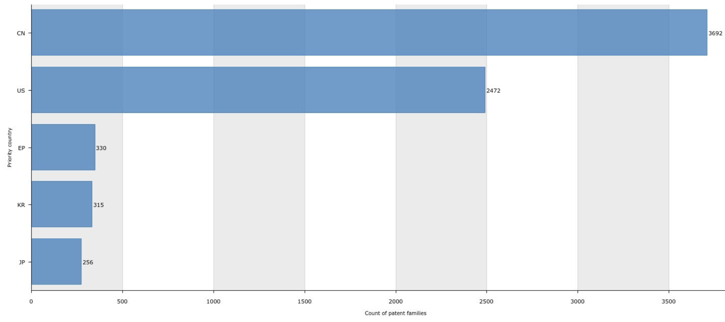
Cas9: Granted Patents and Pending Applications by Family: Top 5 Priority Countries, Not Including WO
This chart was created on the Questel's IP Business Intelligence application Orbit Intelligence. More information available at questel.com.

Slide 23
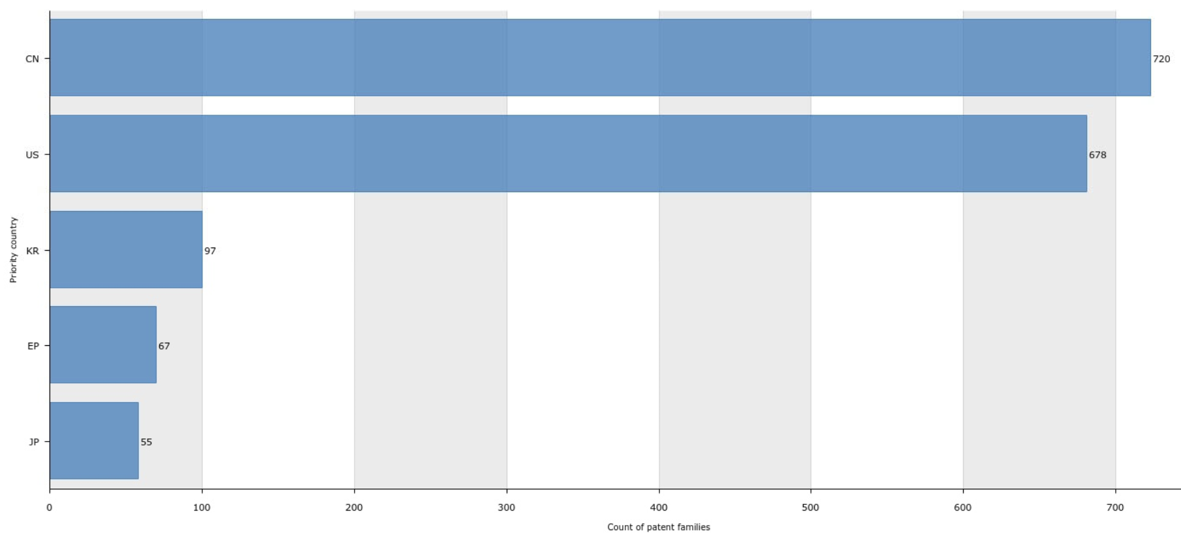
Cas12a: Granted Patents and Pending Applications by Family: Top 5 Priority Countries, Not Including WO
This chart was created on the Questel's IP Business Intelligence application Orbit Intelligence. More information available at questel.com.

Slide 24
CRISPR Contested Proceedings

Slide 25
Background

Slide 26
CRISPR Interferences: Summary

Slide 27
Interference No. 106,048: Broad v. UC

Slide 28
Interference No. 106,115: UC v. Broad

Slide 29
Interference No. 106,115: UC v. Broad

Slide 30
Interference No. 106,115: UC v. Broad

Slide 31
Interference No. 106,126: Broad v. Toolgen

Slide 32
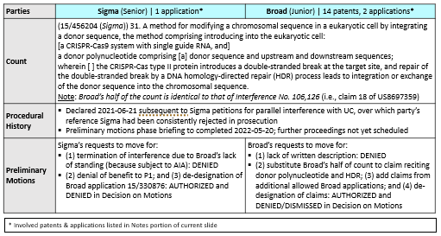
Interference No. 106,133: Broad v. Sigma

Slide 33
CRISPR-Cas9 Therapeutic Licensing Landscape

Slide 34
Cas9 Therapeutic Licensing: Background

Slide 35
CRISPR-Cas9 Therapeutic Licensing: Landscape Summary

